Slide 1
Welcome To Network Class
Instructor:--> Sir Muhammad Faiz Presenter:--> Dilbar Hussain
Topic:--> Multiplexing in Network

Slide 2
Multiplexing
Multiplexing is a method used by networks to consolidate multiple signals -- digital or analog
Multiplexing is the process of combining multiple signals into one signal, over a shared medium.

Slide 3
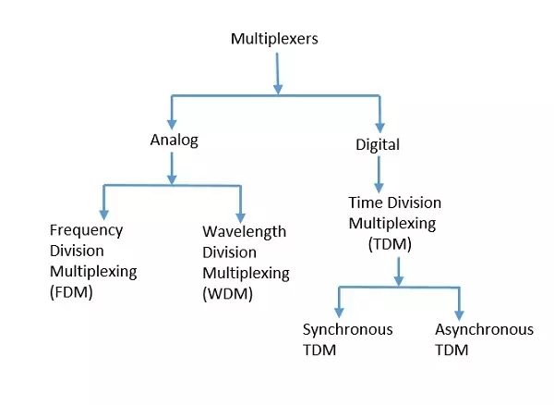

Slide 4
Analog Multiplexing
The analog multiplexing techniques involve signals which are analog in nature. The analog signals are multiplexed according to their frequency (FDM) or wavelength (WDM).

Slide 5
Frequency Division Multiplexing (FDM)
This technique uses various frequencies to combine streams of data, for sending them on a communication medium, as a single signal.
Example: A traditional television transmitter, which sends a number of channels through a single cable, uses FDM.

Slide 6
Wavelength Division Multiplexing (WDM)
Wavelength Division Multiplexing is an analog technique, in which many data streams of different wavelengths are transmitted in the light spectrum. If the wavelength increases, the frequency of the signal decreases.
Example: Optical fiber Communications use the WDM technique, to merge different wavelengths into a single light for the communication.

Slide 7
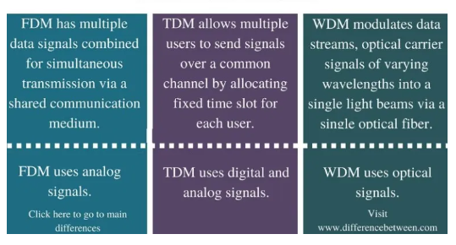
Difference b/w FDM and WDM

Slide 8
Digital Multiplexing
The term digital represents the discrete bits of information. Hence the available data is in the form of frames or packets, which are discrete.

Slide 9
Time Division Multiplexing (TDM)
This technique is used to transmit a signal over a single communication channel, with allotting one slot for each message.

Slide 10
Synchronous TDM
Synchronous TDM is a data transfer approach during which there may be a continuous flow of data signals followed by timing signals. It helps to support that the send and therefore the receiver are synchronized with one another.

Slide 11
Asynchronous TDM
Asynchronous TDM is called statistical division multiplexing. It is a method in which time slots are not permanent as in Synchronous TDM. Time slots are assigned to only those machines which have the information to send the data.

